Slide 1
PACS photometer maps:
several flavors
Roberta Paladini
NHSC/IPAC

Slide 2
The “map-making” problem
With map-making, we mean the process of turning time-ordered data (TOD) into an image projected on the sky
The goal of map-making is not only to create the final 2-d map, but also – and more importantly – to remove all sources of instrumental noise (cfr. 1/f)
In the case of the PACS bolometers, for noise we intend:
1) a spatially correlated 1/f component (common modes of the
bolometers or drift)
+
2) a spatially uncorrelated (although temporally correlated)
per-pixel 1/f component

Slide 3
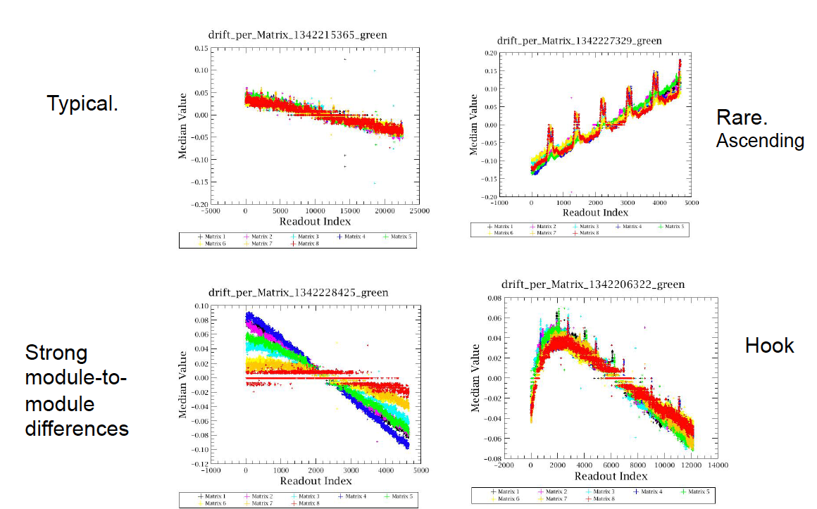
Spatially correlated 1/f (“drift”)

Slide 4
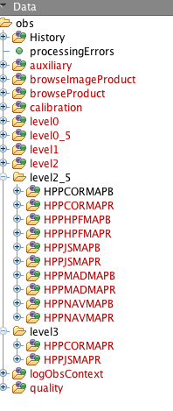
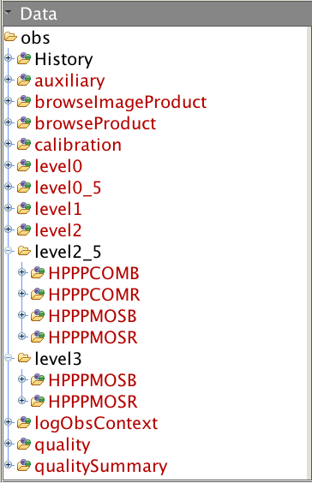
Several maps flavors
SPG 12.1
SPG 11.1
}
MADMap
}
MADMap (corrected map)
}
HPF
}
HPF
}
JScanam
}
HPF
}
MADMap (madmap map)
}
MADMap (naïve map)
MADMap (corrected map)
JScanam

Slide 5
Why is that ? Historically…
Historically, 2 different mappers were implemented in HIPE to answer the needs of different astronomical communities:
High-Pass Filter (HPF): this approach is optimal for the case of isolated point sources, when the science interest is on the source only, not on the surrounding environment
MADMap: this type of processing avoids the filtering of the data, therefore allowing the preservation of extended emission. This approach is preferable when the science interest is both on point sources and its surroundings

Slide 6
In the meanwhile..
Several Herschel Key Programs started developing codes to reduce their PACS data, e.g.:
Scanamorphos
Unimap
These codes are gradually being implemented into HIPE, i.e. Jscanam (JAVA import of IDL Scanamorphos, SPG 12.1) and Unimap (SPG 13.0).

Slide 7
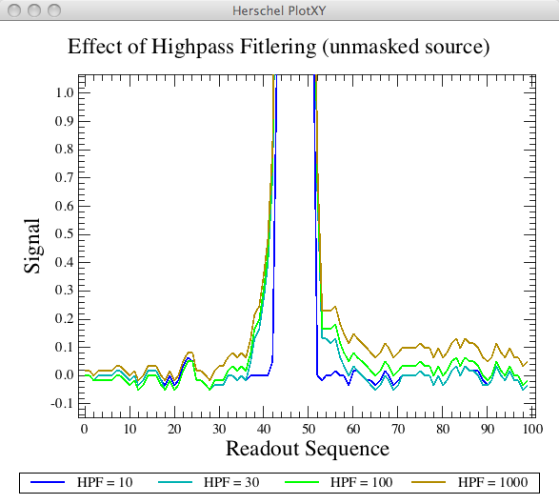
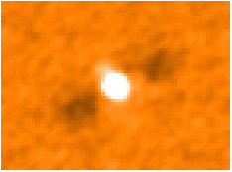
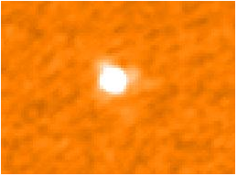
In HIPE: High-Pass Filter (HPF)
Slide a median-filter on individual pixel timelines to remove 1/f noise (both spatially correlated & uncorrelated)
Problem
When a bright source enters the filter box, it alters the estimate of the median
Unmasked High-pass Filtering
Solution:
Mask the source before median-filtering
Masked High-pass Filtering

Slide 8
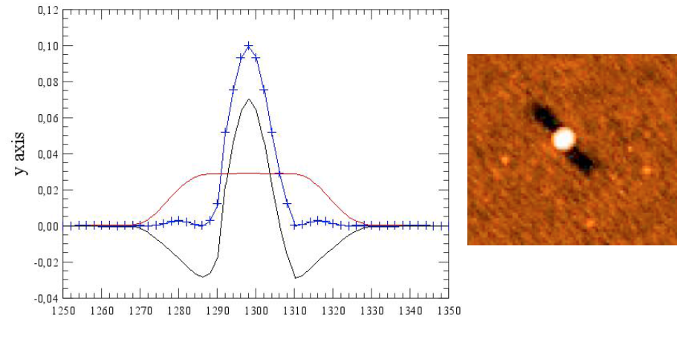
Signs I need to re-process my HPF map
credit: Bruno Altieri
NOTE: another good reason to re-process your data is to use the latest version of calibration files…

Slide 9
If I need to re-process my HPF map:

Slide 10
What to tweak in the script…
1. high-pass filter radius:
* default values: blue = 15 (i.e. 30”), red = 25 (i.e. 50”)
mask radius:
* option 1: source coordinates are known
* option 2: input source catalog
* option 3: blind masking
deglitching
* 2nd level deglitching (→ exploits spatial redundancy, good for bright sources )
* MMT deglitching (→ works in the timelines, good for faint sources)

Slide 11
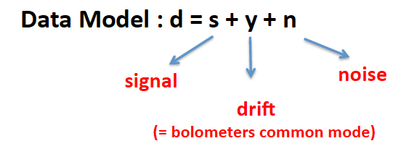
In the following slides, we are going to talk about mappers which preserve extended emission: MADmap, Jscanam/Scanamorphos and Unimap:
MADmap and Unimap are both based on GLS (Generalized Least Square) algorithms, i.e. they are designed to solve the equation:
Jscanam/Scanamorphos (→ Jscanam is the HIPE version of IDL Scanamorphos) are “destripers”: they exploit the redundancy built in a typical observation, i.e. the fact that each portion of the sky is sampled multiple times by multiple bolometers

Slide 12
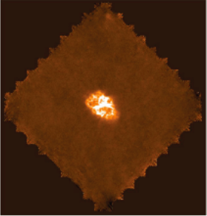
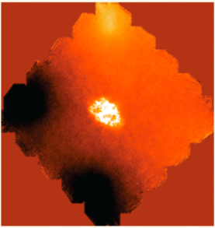
Signs I need to re-process my MADmap, Jscanam/Scanamorphos, Unimap map..
✔
✗
Gradient across the map due to inaccurate drift removal

Slide 13
In HIPE:
MADmap
Originally, MADmap was written by the Berkeley CMB group:
http://newscenter.lbl.gov/feature-.‐stories/2010/02/03/madmap/
MADmap was ported to Java for use in HIPE
What we call now MADmap in the Herschel world has significantly drifted apart from its CMB counterpart → significant addition in PACS to correct for spatially correlated noise (i.e. bolometers drift)
Most interactive re-processing in MADmap deals with this drift correction (→ pre-processing)

Slide 14
NOTE: MADmap has greatly improved in HIPE 12.1. It uses a complete different approach for correcting for bolometers “drift”. Its performance now matches that of Jscanam/Scanamorphos and Unimap!

Slide 15
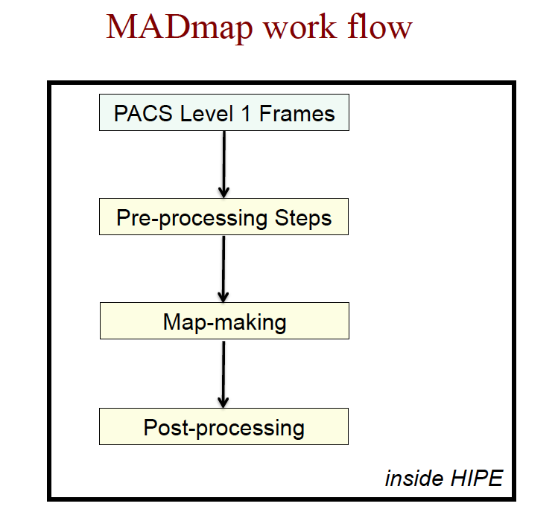

Slide 16
Workflow: more in detail ..
}
Subtract offsets
pre-processing
Exponential drift removal
Iterative drift removal
}
Uncorrelated 1/f removal and map projection
GLS →
actual call to madmap task

Slide 17
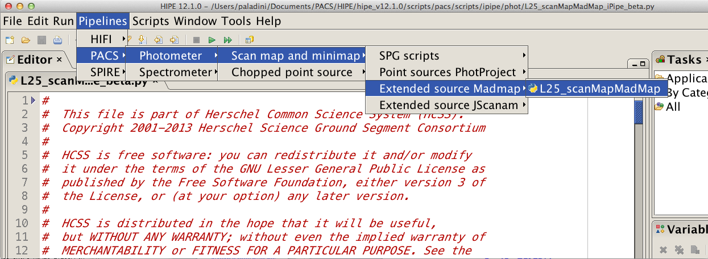
If I need to re-process my MADMap map:

Slide 18
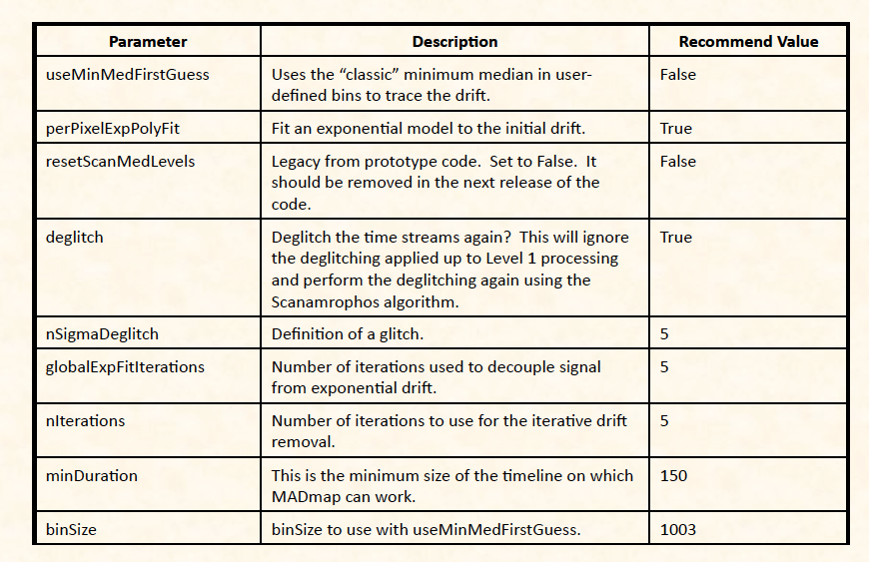
Drift Correction Parameters

Slide 19
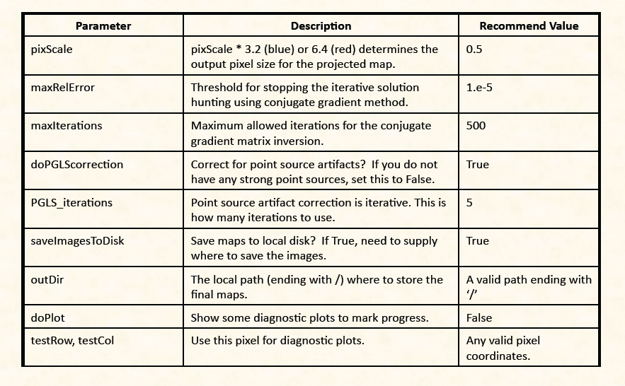
Mapping & Runtime Parameters

Slide 20
In HIPE:
JScanam
Jscanam is the JAVA import of IDL Scanamorphos
NOTE: be aware that JScanam and Scanamorphos are NOT IDENTICAL !If you run both codes, you will notice that the resulting maps will show some differences.

Slide 21
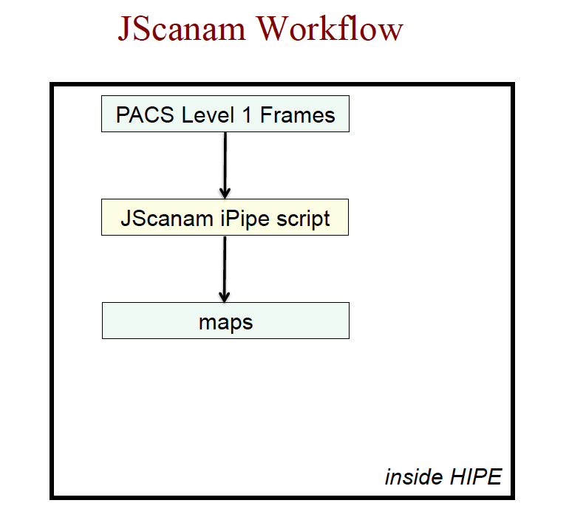
Very similar philosophy of Scanamorphos

Slide 22
If I need to re-process my JScanam map:

Slide 23
Outside of HIPE:
Scanamorphos (H. Roussel)
Scanamorphos was originally developed for Herschel SPIRE and P-Artemis (→ ground-based experiment) data
Scanamorphos is an IDL software
It can be downloaded from:
http://www2.iap.fr/users/roussel/herschel/

Slide 24
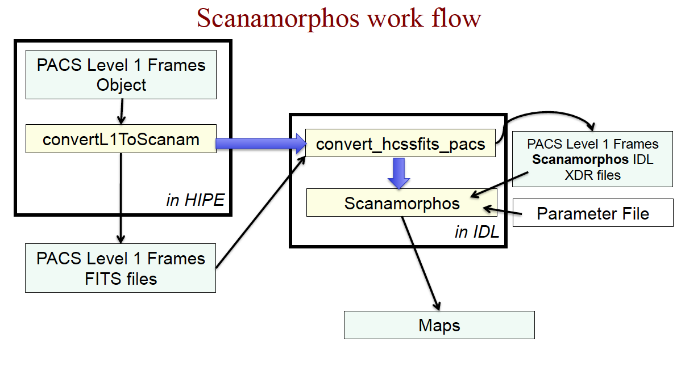

Slide 25
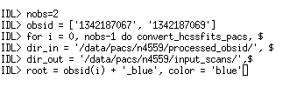
To run Scanamorphos, one has to export PACS Level 1 frames to Scanamorphos format.
This step occurs in two steps:
one in HIPE:
one in IDL:

Slide 26
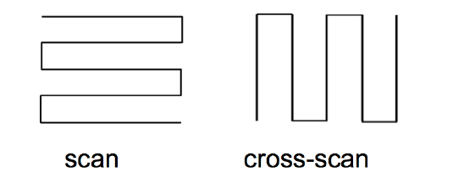
After the conversion of Level 1, before running Scanamorphos, one has to create a list of scans, where scan and X-scans alternate
Ex:
}
stru_1342221146_red_scan1.xdr
stru_1342221147_red_scan1.xdr
stru_1342221146_red_scan2.xdr
stru_1342221147_red_scan2.xdr
……..
}
scan
X-scan

Slide 27
NOTE: Jscanam does not require any file conversion or scan re-ordering !

Slide 28
Workflow: more in detail ..
Baseline removal
Average drift removal
Individual drifts removal
Final map projection

Slide 29
Main Scanamoprhos Parameters
Parameter | Description
/parallel | for parallel mode observations
/galactic | to use where extended emission dominates the map
/minimap | for “mini-scan” maps
/nocross | when only one scan direction is available
/jumps_pacs | detect and mask “jumps” in the data
/nothermal | skip short-timescale average drift subtraction
/noglitch | skip Scanamorphos’ internal deglitching
nblocks | forces slicing of data into “nblocks”
pixsize | pixel size of the final map
orient | “astro” (North up, East to the left) or “scan”
/frame_framallscans | use all scans to compute WCS, not only first two
hdr_ref | use reference header in “hdr” for map projection
/one_plane_fits | produce separate FITS files for each plane instead of a cube

Slide 30
Outside of HIPE:
Unimap (L. Piazzo)
Unimap is the successor of ROMAGAL (→ Hi-GAL) and ROMA (BOOMERang & Planck)
Unimap consists of a MATLAB wrapper around a C code
Compiled version can run w/o MATLAB
Compatible with Linux, Mac, Windows. Compiled version currently distributed for Linux and Mac (64-bit machines)
The code can be downloaded from:
http://w3.uniroma1.it/unimap/

Slide 31
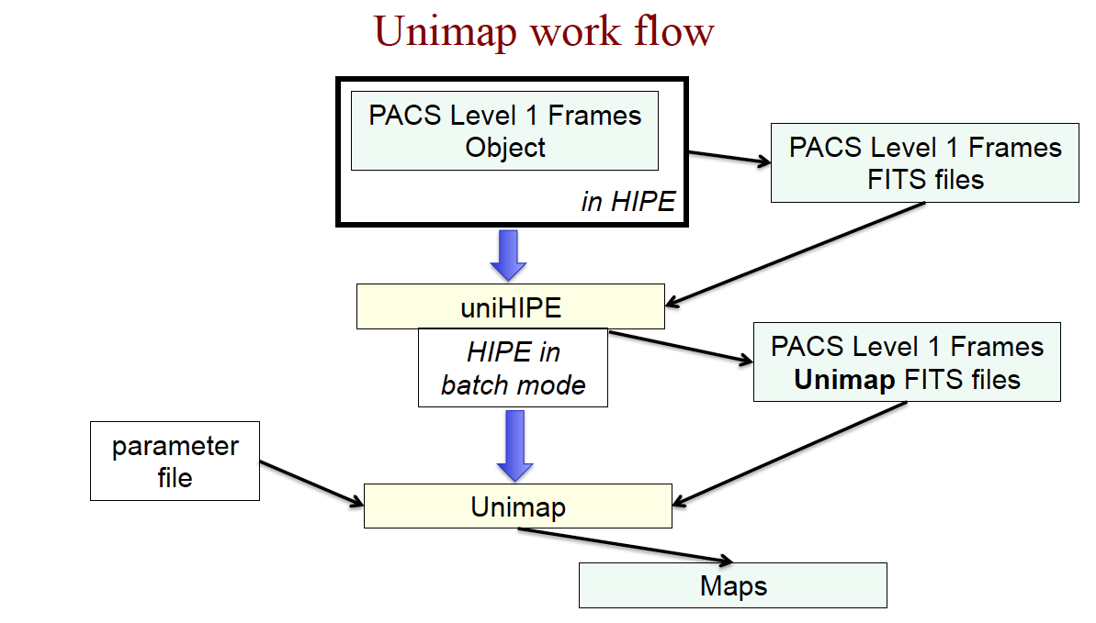

Slide 32
To run Unimap, one has to export PACS Level 1 frames to Unimap format.
This step is performed by UniHIPE:
http://herschel.asdc.asi.it/index.php?page=unimap.html
NOTE: Unimap is being implemented in HIPE 13.0. This means that Unimap products will be generated in the next bulk reprocessing, and that a Unimap ipipe script will be available from the menu. The script
will allow Unimap re-processing by skipping the Level 1 conversion part.

Slide 33
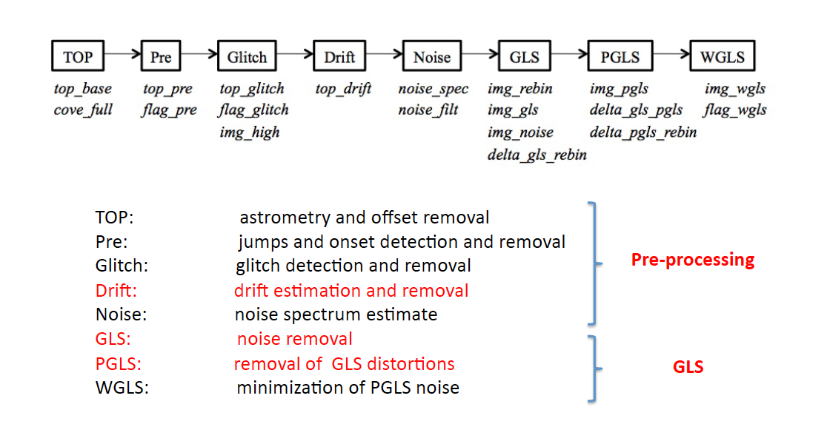
Workflow: more in detail ..

Slide 34
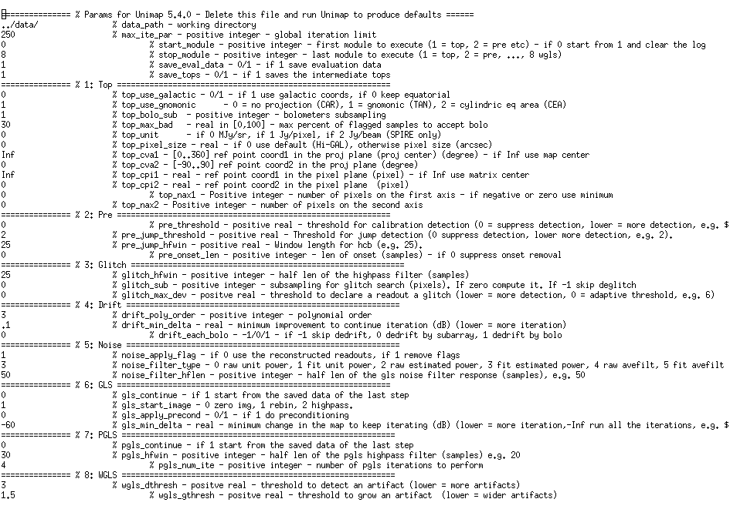
Unimap Parameters

Slide 35
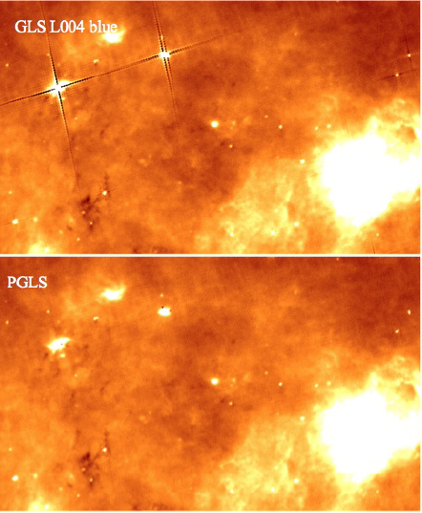
One word about “crosses”
The GLS processing (i.e. MADmap, Unimap, etc..) can introduce artifact in the form of “crosses”
This type of artifact is corrected for in both the MADmap and Unimap scripts in the “post-processing” phase (PGLS)

Slide 36
Usual Question:
Ok, we have seen what the different flavors are …so which is the BEST ??

Slide 37
To answer this question, in March 2014, we (i.e. the PACS instrument team) have performed a new systematic comparison of the codes, i.e. MADmap, Unimap and JScanam
The result of this comparison is summarized in a public report available from the PACS calibration wiki:
http://herschel.esac.esa.int/twiki/pub/Public/PacsCalibrationWeb/pacs_mapmaking_report14_v2.pdf
NOTE: the March 2014 comparison supersedes the comparison done in January 2013 (i.e. ESAC map-making workshop)

Slide 38
The March 2014 comparison was done using:
2 reference data sets →
Abell 370
M16
3 different metrics →
Power spectrum
Difference matrix
Point source photometry

Slide 39
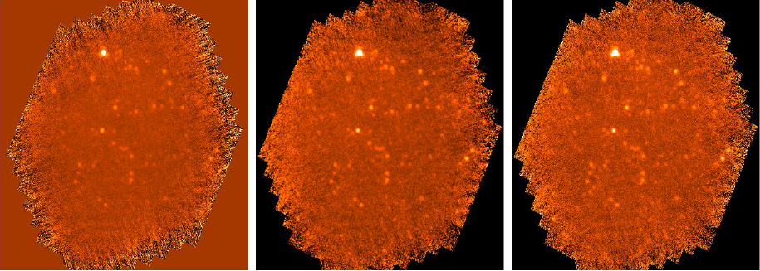
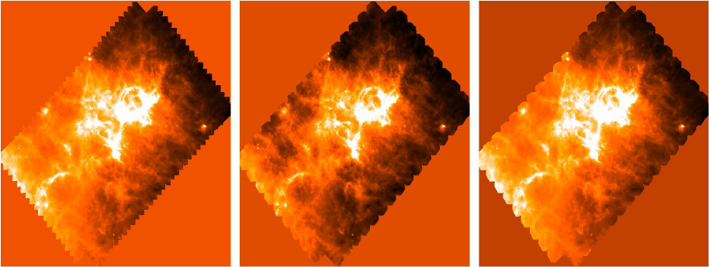
Abell 370 -
PACS 100 μm
JScanam
MADmap
Unimap
M16 -
PACS 160 μm
JScanam
MADmap
Unimap

Slide 40
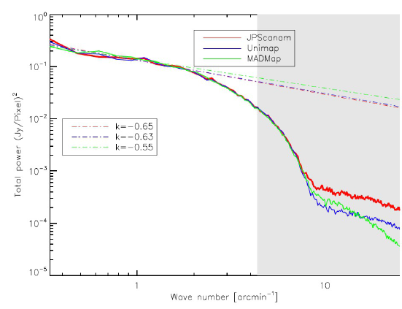
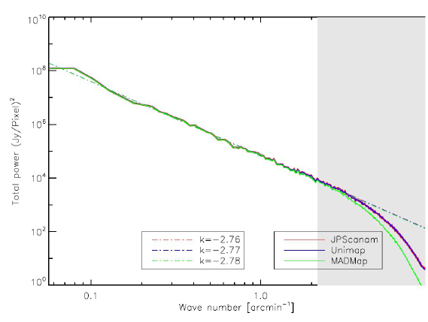
Results: I – Power Spectrum Analysis
Abell 370 -
PACS 100 μm
M16 -
PACS 160 μm
The grey area denotes angular scales equal or smaller than the instrument beam

Slide 41
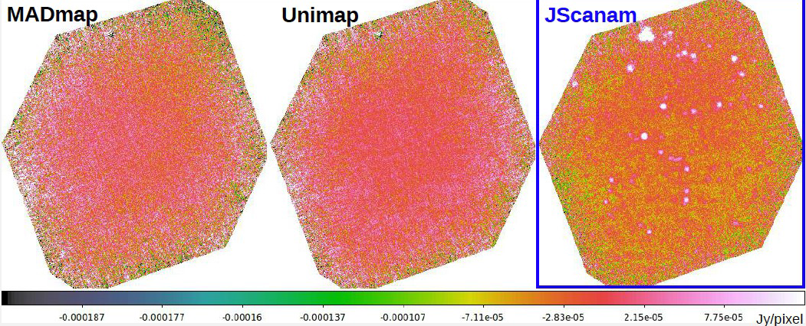
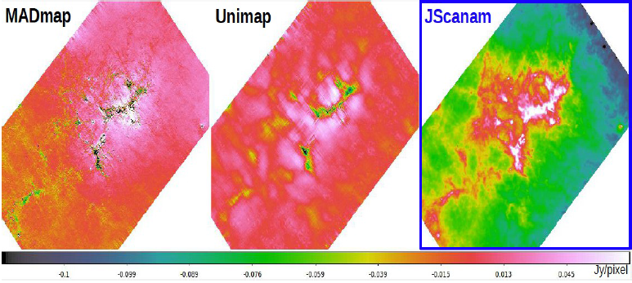
Results: II – Difference Matrix
Abell 370 -
PACS 100 μm
M16 -
PACS 160 μm

Slide 42
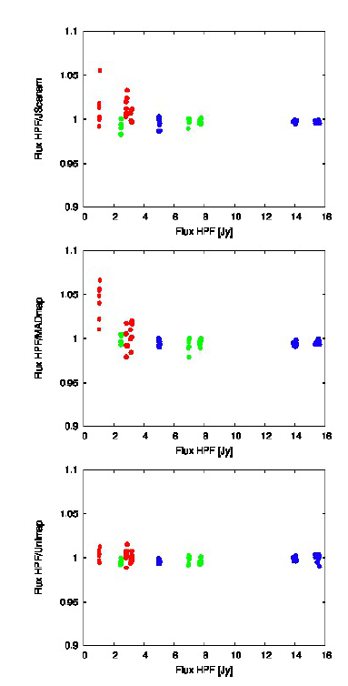
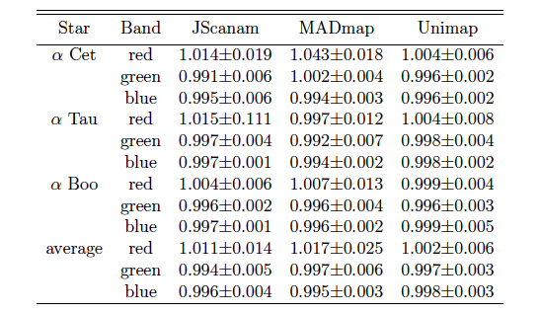
Results: III – Point Source Photometry / 1- 15 Jy
HPF/JScanam
HPF
HPF/MADmap
HPF
HPF/Unimap
HPF

Slide 43
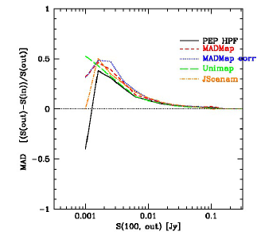
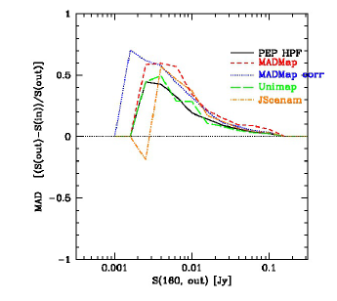
Results: III – Point Source Photometry / 0.001 – 0.1 Jy

Slide 44
Summary:
(power spectrum analysis:) on angular scales larger than the instrumental beam, no surface brightness removal is observed for any of the 3 mappers
(difference matrix:) the 3 mappers generate very similar maps. Some discrepancies may appear when using very small pixels (i.e. 1” in the blue and 2” in the red) for map projection
(point-source photometry:) for the 3 mappers point source photometry is in agreement with the results from HPF down to ~1%
Conclusion: Jscanam, MADmap and Unimap provide very similar results, so it’s up to you and your taste (e.g. work inside our outside of HIPE, etc.) which one you want to use !

Slide 45
Additional Resources
Processing large PACS data sets, especially for the photometer, requires large memory allocations (64 GB or more). You can request a remote user account on our virtual system at NHSC. For more information, visit:
To start on PACS (and SPIRE) map-making, you can visit the NSHC map-making wiki at:
https://nhscsci.ipac.caltech.edu/sc/index.php/CompSupport/ExternalUsers
https://nhscsci.ipac.caltech.edu/sc/index.php/Mapping/HomePage

