Slide 1
Photometry Guidelines
for PACS data
Roberta Paladini
NHSC/IPAC

Slide 2
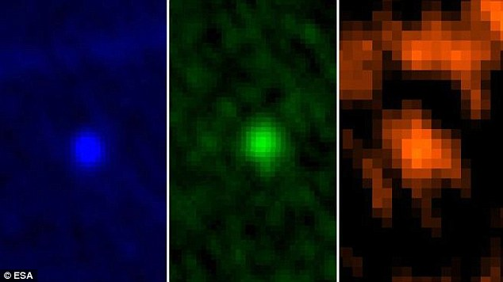
I have a PACS image and want to do source photometry.
70 μm
100 μm
160 μm
How do I proceed ? Are there any official guidelines ?

Slide 3
Point Source Photometry
which map to use (i.e. which level ?)
which tool (i.e. task in HIPE or software outside of HIPE) ?
which corrections to apply ?
Extended Source Photometry
which map to use (i.e. which level ?)
which tool (i.e. task in HIPE or software outside of HIPE) ?
which corrections to apply ?
+
Calibration & error maps
beams

Slide 4
Point Source Photometry
Which map do I use ?
Levels: if Level 3 is present, then go for Level 3. Otherwise, go for Level 2.5
Map in a given Level: the PACS photometer pipeline comes in different flavors: HPF, MADMap, JScanam (see this afternoon’s talk).
In the ongoing bulk reprocessing (i.e. SPG 12.1), all the flavors are
photometrically equivalent (down to ~1%) for point-sources! For
more information, see:
http://herschel.esac.esa.int/twiki/pub/Public/PacsCalibrationWeb/pacs_mapmaking_report14_v2.pdf

Slide 5
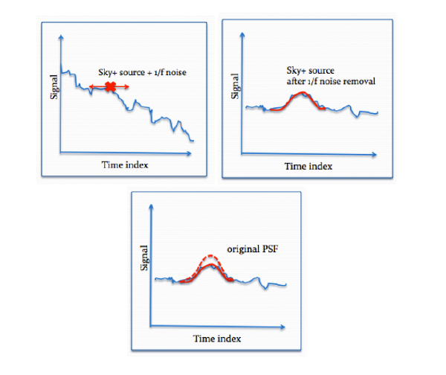
A word of caution about HPF
HPF induces a flux loss (~1-2%) even after properly masking the sources
Popesso et al. 2013, astro-ph/

Slide 6
Point Source Photometry
Is there a recommended task or tool ?
Compared to SPIRE (cfr. timeline fitter) we do not have a dedicated tool or HIPE task to do photometry
PACS is calibrated using aperture photometry of fiducial stars
(see calibration paper: Balog et al., 2013,ExA, 37, 129)
There is no preferred “tool” for aperture photometry (you can do it in HIPE or using other software). However, there are preferred apertures (see following slide)

Slide 7
Recommended source and sky apertures (arcsec)
Blue Green Red
Source aper 12 (5.5) 12 (5.6) 22 (10.5)
Sky aper (inner) 35 35 35
Sky aper (outer) 45 45 45
For sources fainter than ~ 500 mJy, smaller apertures are recommended (see values in parenthesis).

Slide 8
Aperture Photometry in HIPE
CASE 1: I have my .fits file and only want to do
aperture photometry
CASE 2: I want to re-process my data and do
aperture photometry
(→ this will likely not be your case..)

Slide 9
CASE 1: I have my .fits file and only want to do aperture photometry
Task in HIPE !
annularSkyAperturePhotometry()
annular or rectangular (rectangularSkyAperturePhotometry) sky aperture
user can provide fixed sky value (fixedSkyAperturePhotometry)
5 algorithms to estimate sky: average, median, mean-median, mode, daophot
both GUI and command line versions

Slide 10
The script:
It performs aperture photometry
It applies aperture corrections
It identifies the position of the source through fitting procedure (BUT: source assumed near FOV center)
It works on:
Level 2, Level 2.5 or Level 3 images

Slide 11
The script:
It performs aperture photometry
It applies aperture corrections
The position (RA/DEC) of the sources is provided in an input ASCII file
It works on:
Level 2, Level 2.5 or Level 3 images

Slide 12
CASE 2: I want to reprocess and do aperture photometry
Use the same script for the HPF reprocessing !
The script:
It allows to reprocess PACS photometer data (using HPF)
It performs aperture photometry
It applies aperture corrections
It identifies position of the source through iterative procedure
For faint sources, position can be supplied by providing RA, DEC

Slide 13
Aperture Photometry outside of HIPE: e.g IDL
NOTE: PACS Level 2, Level 2.5 and Level 3 maps are .fits files. So you can always export them into another environment, i.e. outside of HIPE !
Example: α-Boo @ 70 μm
download the tarball from the HSA: rpaladin176460473.tar
“extract” the Level 2 map (need to unzip the .fits file):
→ rpaladin176460473/1342211280/level2/HPPPMAPB/hpacs1342211280_20hpppmapb_1374160924489.fits
in IDL:
IDL > mosaic = mrdfits(‘hpacs1342211280_20hpppmapb_1374160924489.fits’,1,h)
MRDFITS: Image array (342,489) Type=Real*
IDL > aper,mosaic,x_{c},y_{c}, flux, eflux, sky,skyerr, 1, [2],[4,6], -1,/exact,/flux
Star X Y Sky Fluxes
0 170.00 243.50 0.00 1.2 +- 1.1

Slide 14
Source Detection and PSF Fitting
inside & outside HIPE
In HIPE:
two detection algorithms which work with both PACS and SPIRE data:
sourceExtractorSussextractor()
sourceExtractorDaophot()
Outside HIPE:
Sextractor
StarFinder (used by many teams: PEP, HOPS, etc..)
Daophot
Spitzer/Apex

Slide 15
NOTE: Several Galactic programs developed their own detection/extraction tools
Publicly Available Tools:
getSources: (→ Gould Belt Survey)
http://www.herschel.fr/cea/gouldbelt/en/getsources
CUTEX (→ Hi-GAL survey)
http://herschel.asdc.asi.it/index.php?page=cutex.html
boloSource():
http://herschel.esac.esa.int/2013Mapmaking.shtml

Slide 16
Point Source Photometry
Which corrections do I need to apply ?
Aperture Corrections (→ aperture photometry)
Color Corrections

Slide 17
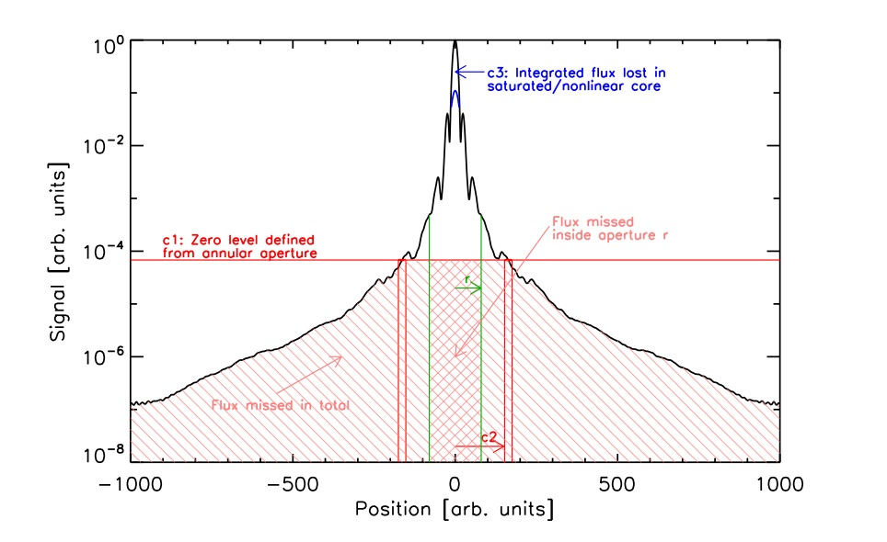
Aperture Corrections
Any aperture photometry performed with a given source aperture radius is inevitably affected by flux loss, due to the fact that any finite radius cannot “capture” all the source flux
To correct for this effect, one has to apply aperture corrections
For PACS, aperture corrections are defined in terms of Encircled Energy Fractions (EEFs):
Point Spread Function

Slide 18
Task in HIPE !
photApertureCorrectionPointSource()
output from
annularSkyAperturePhotometry task
calTree version
blue, green, red

Slide 19
Aperture corrections are also contained in the calTree
HIPE > calTree=getCalTree()
HIPE > apCorr = calTree.refs[“photometer”].product.refs[“apertureCorrection”].product
HIPE > apCorr_r = apCorr[“fm7ApertureRadius”].data
HIPE > apCorr70 = apCorr[“fm7BandBlue”].data
HIPE > apCorr100 = apCorr[“fm7BandGreen”].data
HIPE > apCorr160 = apCorr[“fm7BandRed”].data
If you want to apply aperture corrections outside of HIPE, you can find them in Table 2 of the PACS photometer calibration paper (Balog et al., 2013)

Slide 20
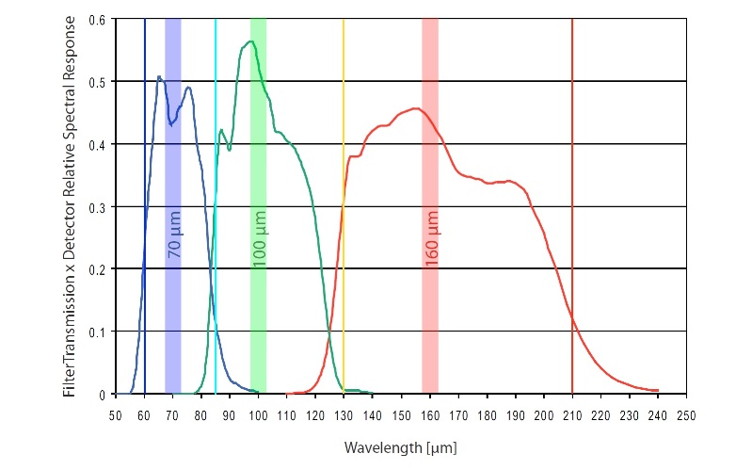
Color Corrections
Color corrections are needed to convert PACS monochromatic flux densities (→ νF_{n} = λF_{l} = const) to the true object SED flux densities at the PACS reference wavelengths (70 μm, 100 μm, 160 μm)
The effective response of the PACS filter is given by:
Filter Transmission X Detector Relative Spectral Response
HIPE > cal = getCalTree().photometer.absorption
HIPE > cal = getCalTree().photometer.filterTransmission
Color corrections for various source SEDs can be found in PICC-ME-TN-038:
http://herschel.esac.esa.int/twiki/pub/Public/PacsCalibrationWeb/cc_report_v1.pdf

Slide 21
Extended Source Photometry
Which map do I use ?
Levels: if Level 3 is present, then go for Level 3. Otherwise, go for Level 2.5
Map in a given Level: for extended sources, DO NOT USE HPF maps. In these maps, because a high-pass filter is applied, all the extended emission is removed, and only point sources are retained.
Therefore, you want to USE either Jscanam or MADMap maps.

Slide 22
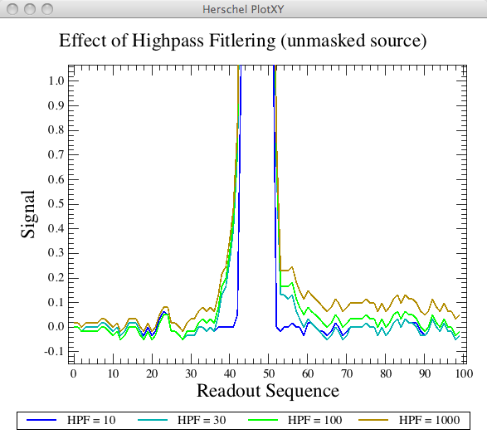
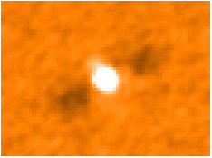
Why cannot use HPF maps with extended sources ?
(→ preview of this afternoon’s talk)
High-Pass Filter concept: slide a median-filter on individual pixel timelines to remove the noise
Problem
If you have a source (point-like or extended) in the filter box, this alters the estimate of the median
Unmasked High-pass Filtering
The solution for point-sources is to apply a mask to protect them from the action of the filter. There is NO SOLUTION for extended sources: if you make the mask too big, you end up with a bad noise removal and you compromise the quality of your data.

Slide 23
Extended Source Photometry
which tool (i.e. task in HIPE or software outside HIPE) ?
→ same as for point-sources: NO RECOMMENDED procedure
which corrections to apply ?
→ same ad for point sources: aperture corrections (for
aperture photometry) & color corrections

Slide 24
Calibration
PACS photometer flux calibration is based on the observations of
5 fiducial stars (β And, α Cent, α Tau, α Boo, γ Dra)
These primary calibrators are complemented with a set of secondary calibrators, namely 18 large main-belt asteroids
Observation of these calibrators leads to a PACS calibration accuracy of the order of ~5% in all bands (→ NOTE: this figure is dominated by model uncertanties)

Slide 25
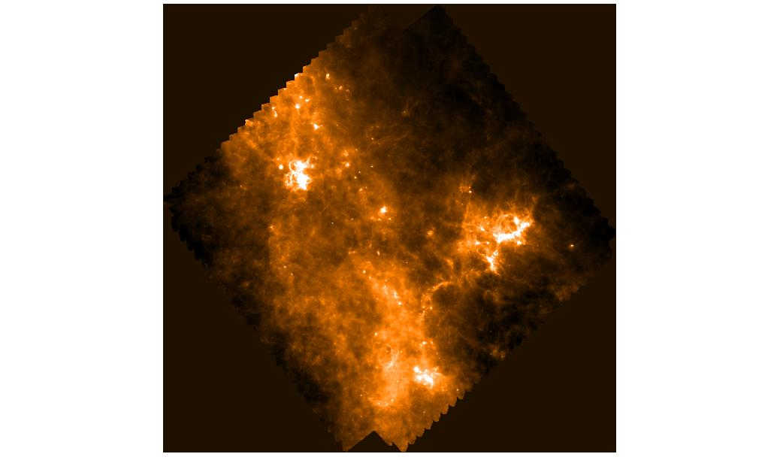
PACS absolute zero-level
The absolute zero-level of PACS data is NOT defined. This is VERY IMPORTANT for extended emission measurements → the surface brightness in the PACS map cannot be taken as a face value
If I need to do ABSOLUTE measurements of extended emission, I ALWAYS need to subtract a background first. There are several ways of doing this: 1) subtract median of the map, 2) perform a 2-d fit of the map after convolving to lower resolution and than subtract it from the map, etc.
If I want to determine the zero-level by comparison with ancillary data sets (e.g. Planck), make sure you do not perform wild extrapolations in wavelengths, which may introduce bigger uncertainties than the problem you are trying to solve

Slide 26
Error maps
There are some softwares for photometry (i.e. SExtractor) which require an input error map.
The various PACS map-making flavors either do not provide an error map (i.e. HPF and Jscanam) or only provide an indicative error map (i.e. MADMap). None of them provides an error map which takes into account
the correlated noise which is introduced by frame co-addition (the actual
map-making process) and the errors associated with each step of the
processing (i.e. median-filtering, drift removal, etc.).

Slide 27
Error maps:
a solution exists for HPF maps
Task in HIPE !
photCoverage2Noise()
NOTE: the task can be applied only to observations obtained in medium (20”/sec) or fast (60”/sec) scan speed mode.

Slide 28
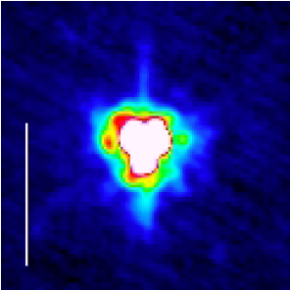
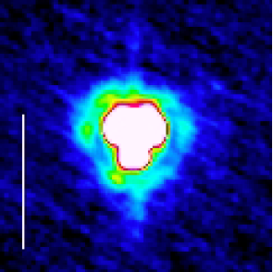
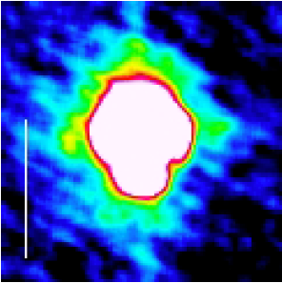
PACS Photometer Beams
(→ http://herschel.esac.esa.int/twiki/pub/Public/PacsCalibrationWeb/bolopsf_20.pdf)
Best available PSFs: from observations of Vesta asteroid:
Ex: 20”/sec
Ex: 20”/sec
Ex: 20”/sec
70 μm
100 μm
160 μm
→ The Encircled Energy Fractions (i.e. aperture corrections) are derived by combining Vesta and Mars observations

Slide 29
The PACS photometer PSF is characterized by:
a narrow core, round in the blue and green bands, but slightly elongated in the Z-direction in the red
A tri-lobe pattern in all bands (but mostly in the blue). It is due to imperfect shape of the primary mirror
“knotty” structures – i.e. diffraction rings – in the blue and green

Slide 30
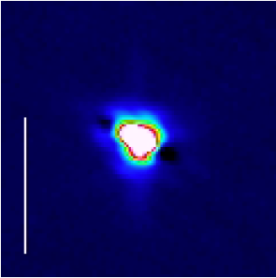
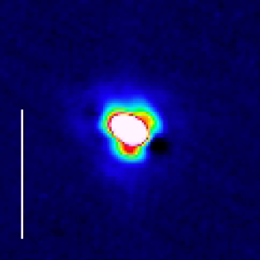
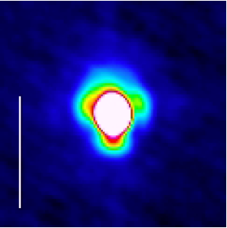
For fast scan (60”/sec) in normal and parallel mode, the PSF is smeared in the scan direction, due to on-board averaging and detector time constants:
60”/sec
60”/sec
60”/sec
70 μm
100 μm
160 μm

Slide 31
Why is this important for photometry ?
If you are interesting in PSF fitting rather than aperture photometry:
if possible, derive a PSF from your own data. The advantage is that the derived PSF is customized to your observations scan speed and orientation, as well as to the range of flux densities spanned by your data
alternatively, you can use the Vesta PSF. In this case, you have to make sure to rotate it to match the profile in your images. Also, remember to select – from the available library – the PSF obtained at the same scan speed of your observations (i.e. 10”/sec, 20”/sec, 60”/sec)
The Vesta PSFs can be downloaded at:
hscsci.ipac.caltech.edu/pacs/data/PSFs/vesta20091109
or:
ftp://ftp.sciops.esa.int/pub/hsc-calibration/PACS/PSF/

