Slide 1
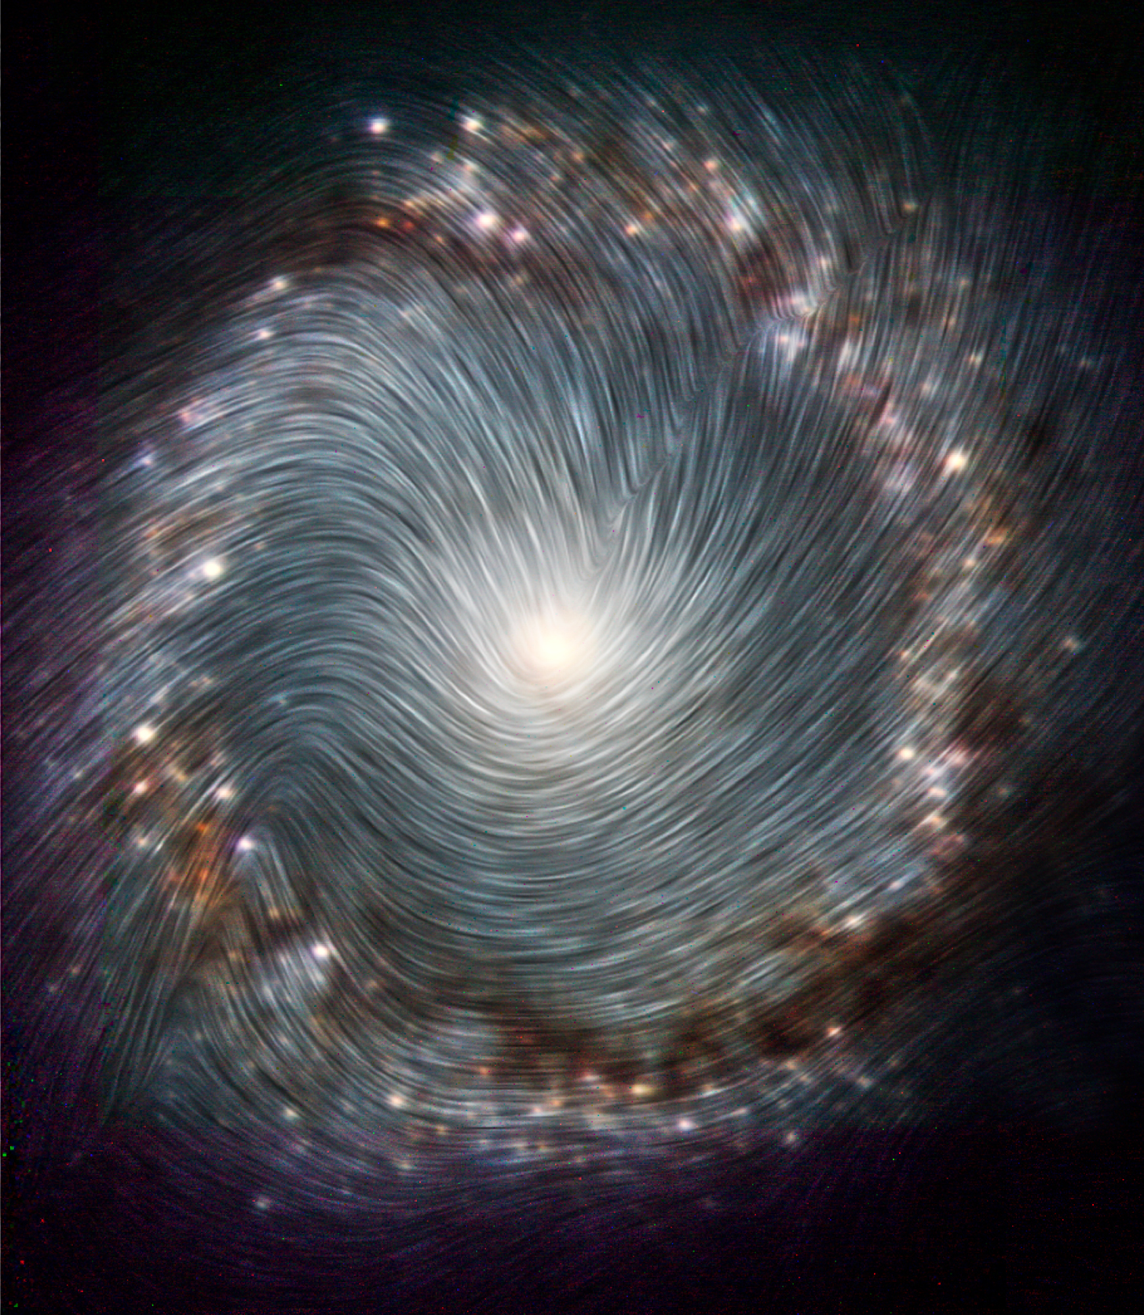
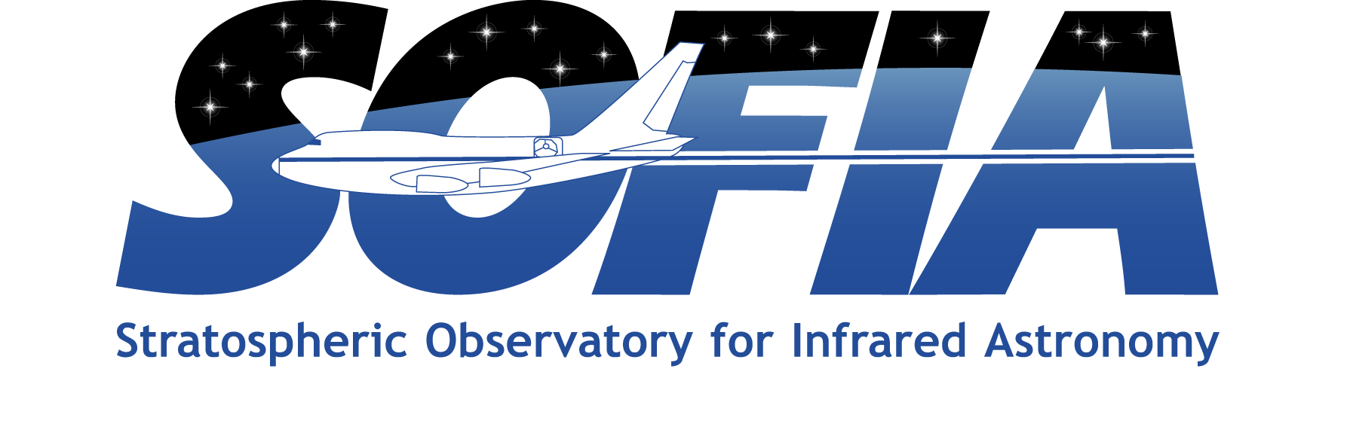

Magnetically-Driven Flows in NGC 1097
SOFIA/HAWC+ measured the magnetic fields in NGC 1097, a barred spiral galaxy with a starburst ring surrounding an active galactic nucleus. These observations in combination with radio polarimetric observations have been able to trace the magnetic fields in the multi-phase interstellar medium in the starburst ring. SOFIA traces the magnetic fields in the dense and warm interstellar medium, while radio polarimetric observations trace the magnetic fields in the diffuse and hot interstellar medium.
Analysis indicates that the spiral magnetic field is the signature of a galactic dynamo action outside and inside the starburst ring. This magnetic field coupled to the diffuse interstellar medium may be dragging material from the host galaxy to the center region. At the same time, the magnetic field in the dense interstellar medium is compressed with a constant orientation at the contact regions feeding the starburst ring. This work shows that the magnetic fields control the transfer of matter from the starburst ring towards the active galactic nucleus and plays a fundamental role in the evolution of NGC 1097.
Image credit: NASA, the SOFIA science team, E. Lopez-Rodriguez et al.; ESO/Prieto et al.
Paper: “Extragalactic Magnetism with SOFIA (Legacy Program) - II: A Magnetically Driven Flow in the Starburst Ring of NGC 1097”
Lopez-Rodriguez, Enrique, et al., 2021/12, ApJ, 923, 150.
Notes:
Paper DOI: http://doi.org/10.3847/1538-4357/ac2e01
High-res image link: https://www.sofia.usra.edu/sites/default/files/2022-03/SCI2022_0004.png
Science Spotlight: https://www.sofia.usra.edu/publications/science-results-archive/magnetically-driven-flows-ngc-1097

