Slide 1
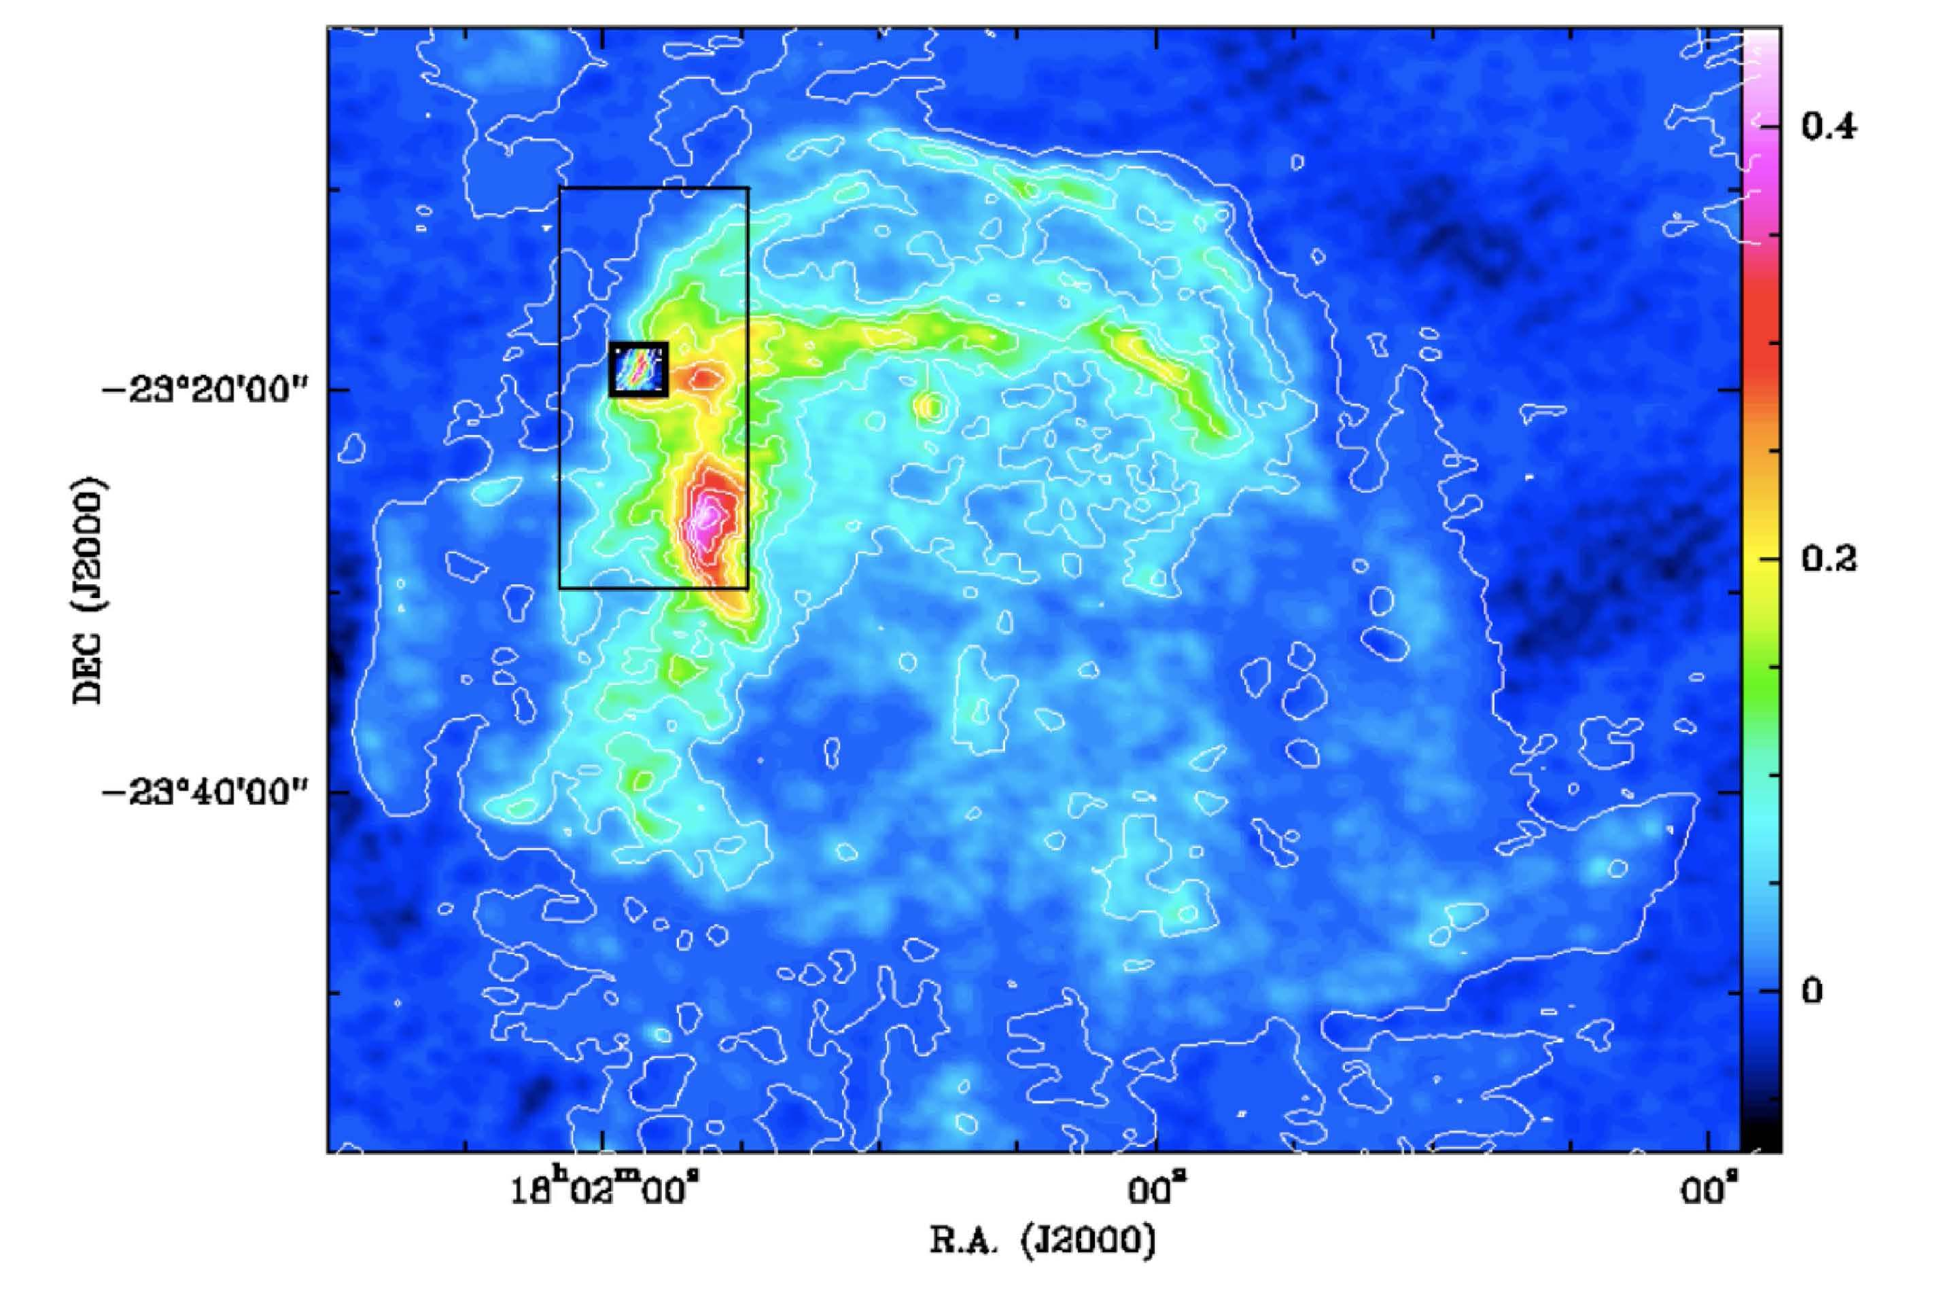
Probing MHD Shocks with high-J CO observations: W28F SOFIA Observations
W28 is a mature supernova remnant (>2x10⁴ yr old) located in the Inner Galaxy (G6.4)
Shocked CO gas interacting molecular clouds
Magnetic field: 2mG
High energy (TeV) γ-ray emission from acceleration of hardronic particles.
Observations
APEX observations
13CO (3-2), CO (3-2), (4-3), (6-5)
SOFIA observations:
CO (11-10) data at 1267 GHz were taken during German deployment flight (Sep 1, 2011)
Gusdorf, et al.

Slide 2
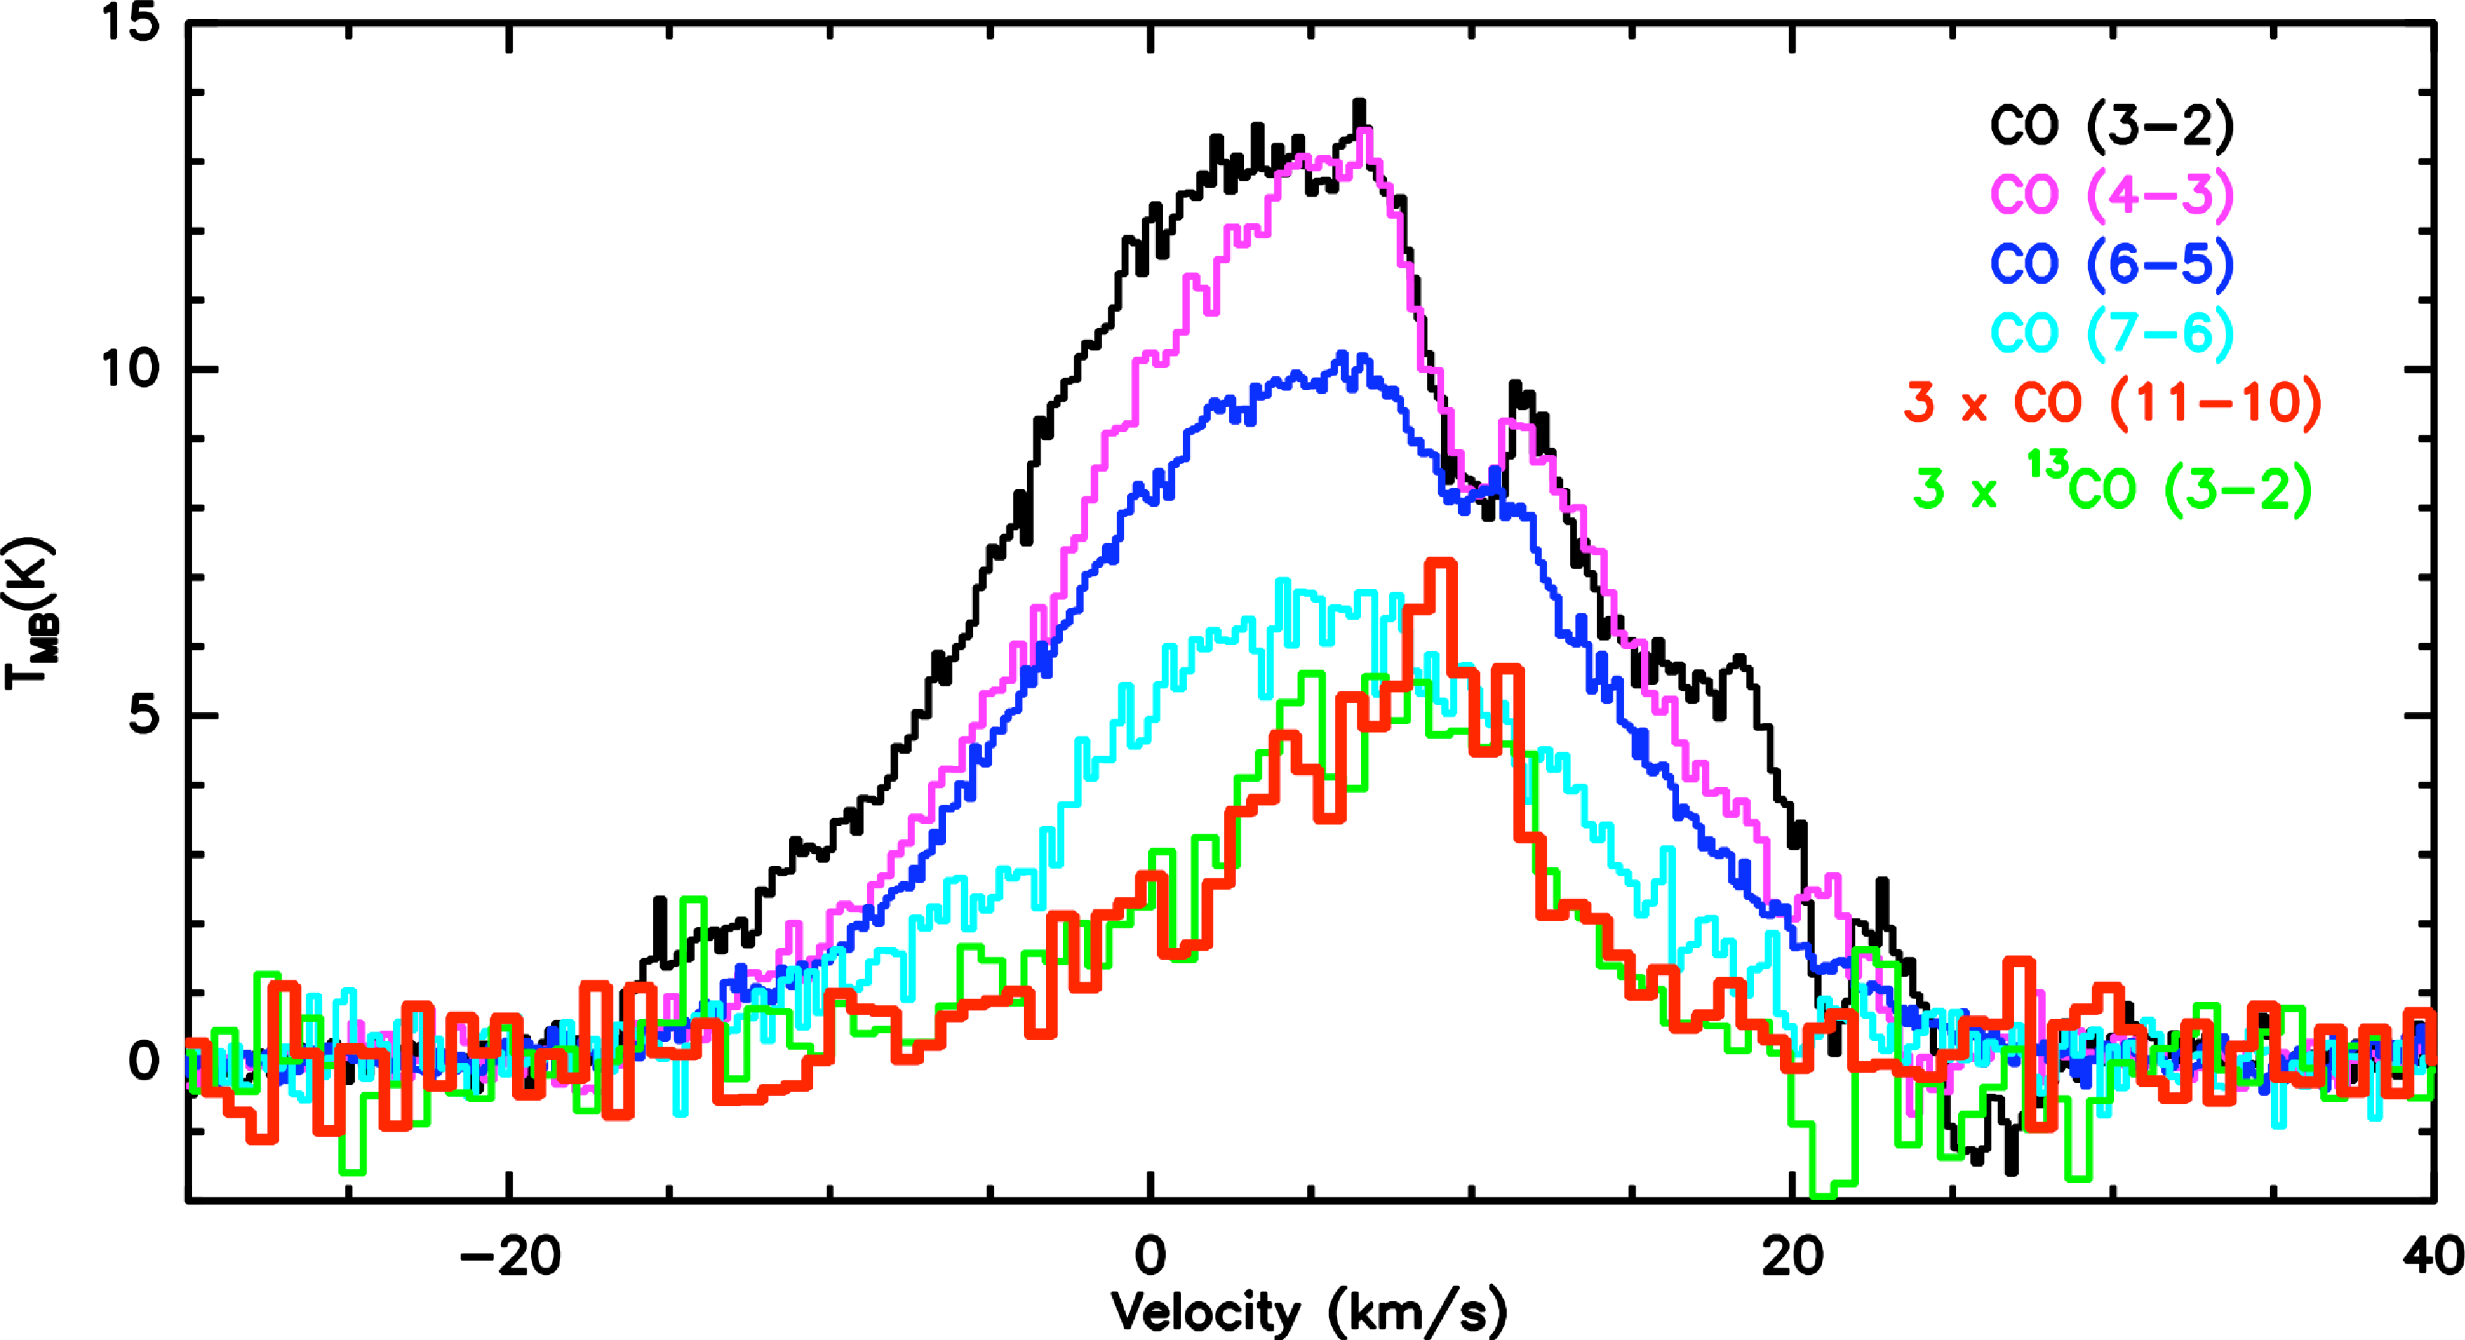
CO spectra profiles
CO line profiles of W28: CO (11-10) profile differs from
other low J CO lines.
Vs (shock velocity): 20 to 25 km/s
Density of 10⁴ to 10⁵ cm⁻³

Slide 3
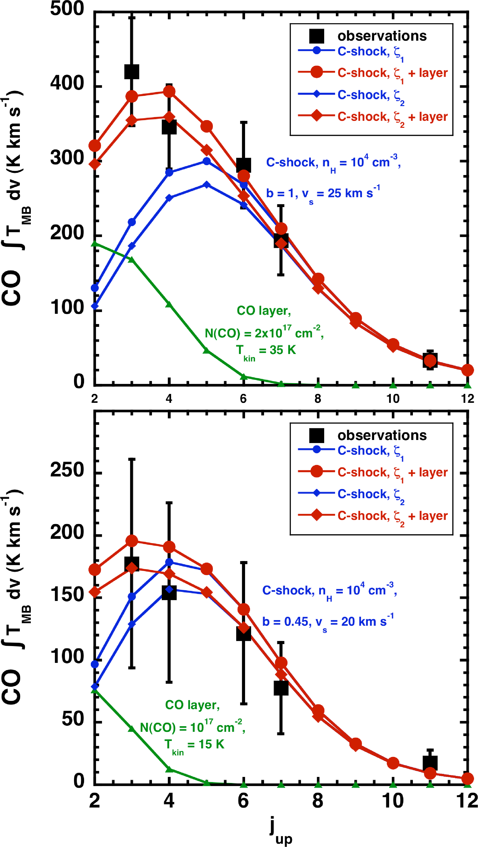
Implication from Shock Model
C-shock (blue) and warm CO layer model (green) can produce the observed CO data.
The shock model requires
cosmic ray ionization rate of
(0.5-3.4) x 10⁻¹⁶ s⁻¹
Data show that
radiation effect is important.

