Slide 1
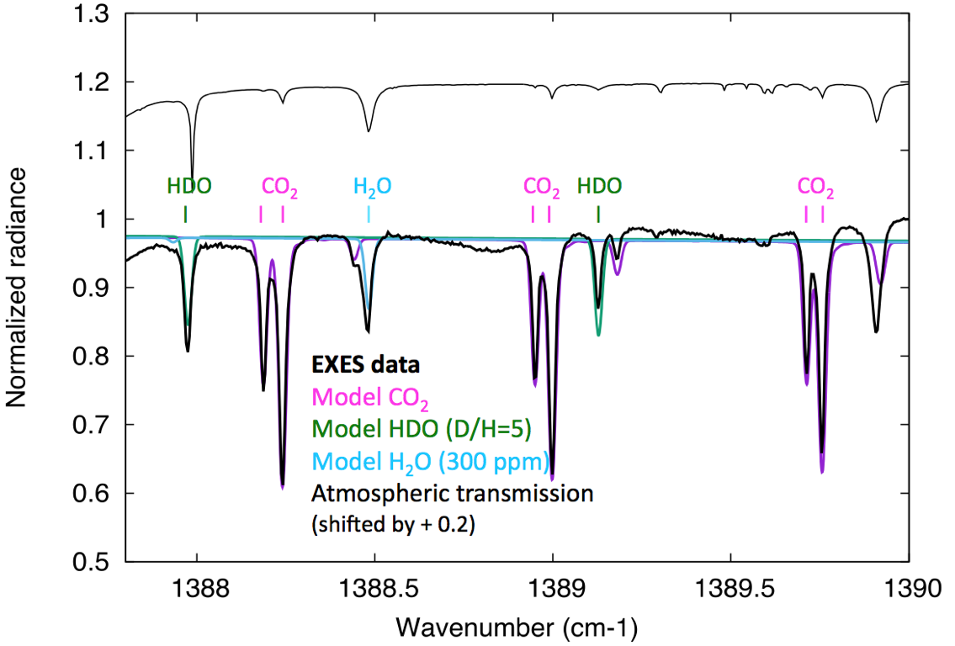
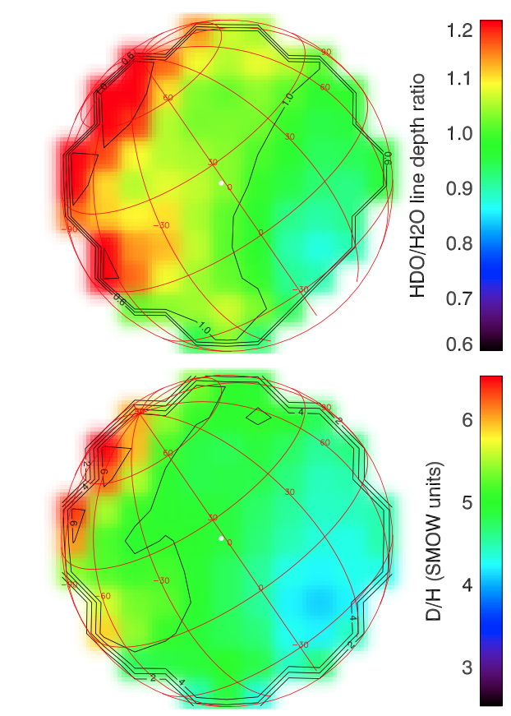
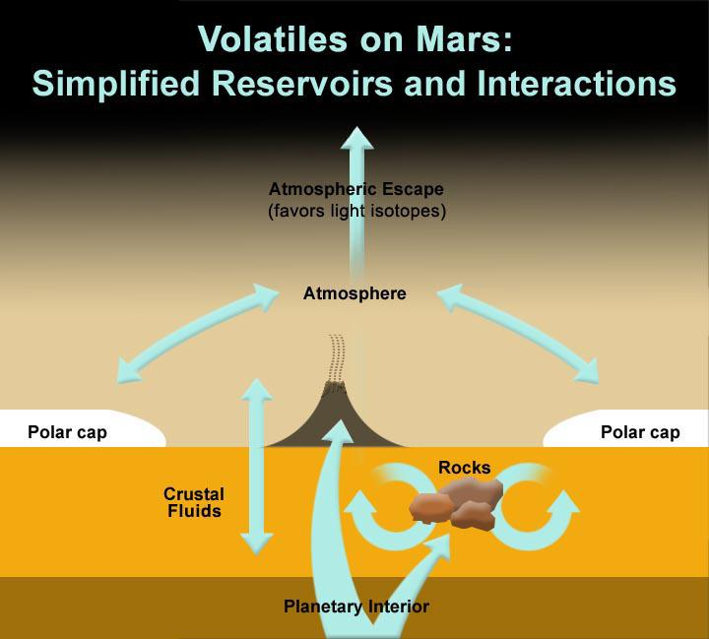
HDO and H₂O on Mars
A map of D/H on Mars in The Thermal Infrared
Encrenaz et al. 2016, A&A, 586, A62
Instrument: EXES, R ~ 100,000
Background:
Deuterium enrichment in the Martian atmosphere is expected due to fractionation through differential escape rates of the heavier HDO and lighter H2O molecules.
EXES Spectrum of Mars at 7.2 μm
Disk-integrated D/H ratio is 4.4 times the standard Earth’s oceans value, consistent with the requirement that most of the water originally present on the Martian surface has been destroyed and has escaped.
D/H is low in the high-altitude Tharsis Plateau. The variation of D/H with location confirms the vapor pressure isotopic effect (VPIE) fractionation mechanism.
EXES permits simultaneous detection of CO2, H2O and HDO. More EXES observations are required to study seasonal variations.
Background Image Credit: Sebastian Voltmer

