Slide 1
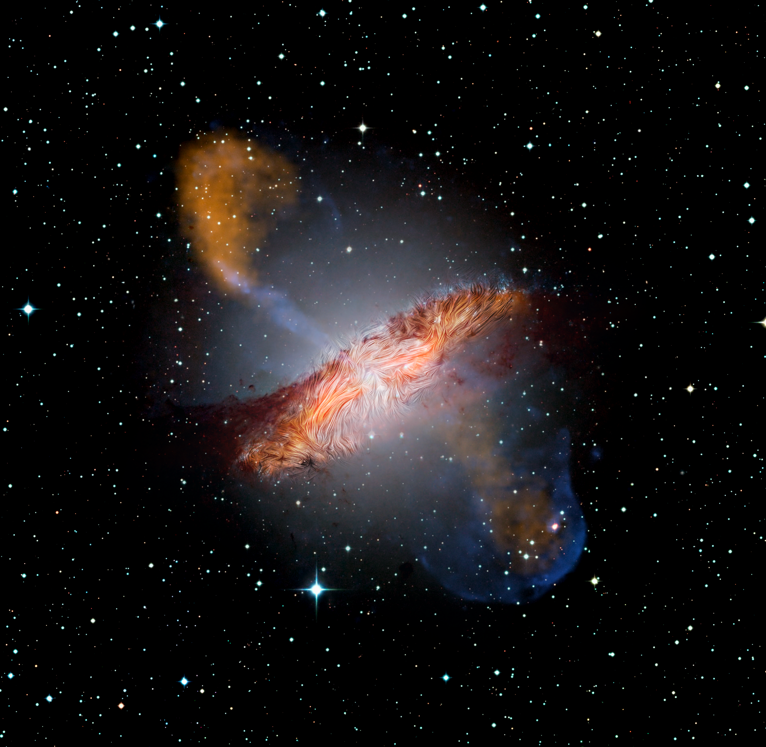
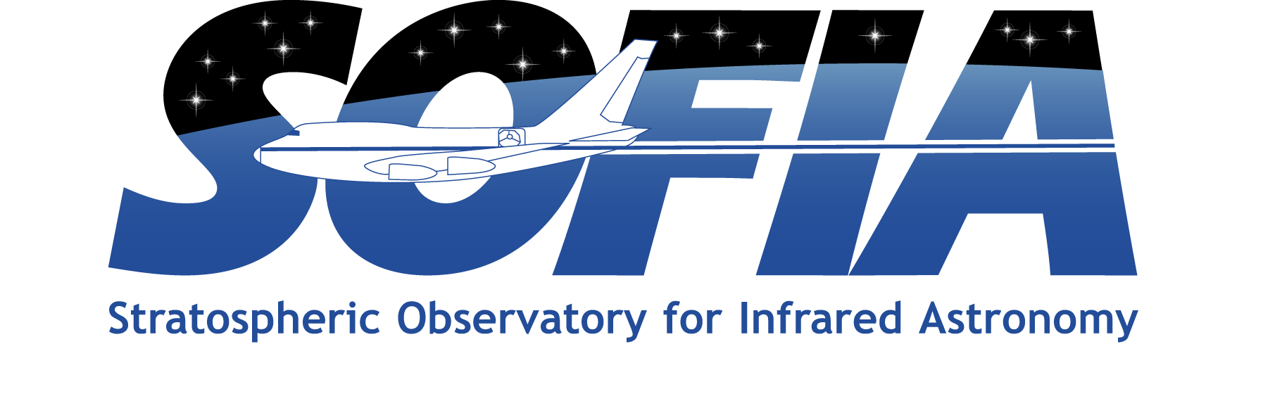

The Warped Magnetic Field of Centaurus A
Centaurus A is the remnant of a galaxy merger and represents one of the best laboratories to study the effects of galaxy mergers on magnetic fields
SOFIA/HAWC+ polarimetric observations show the magnetic field globally aligned with the disk, but with significant dispersion of orientation at small scales
This result implies that small-scale turbulence is distorting and enhancing the original large-scale magnetic field
Paper: “The Magnetic Field Across the Molecular Warped Disk of Centaurus A”
Lopez-Rodriguez, E., Nat Astron (2021).
Image credit: Optical: European Southern Observatory (ESO) Wide Field Imager; Submillimeter: Max Planck Institute for Radio Astronomy/ESO/Atacama Pathfinder Experiment (APEX)/A.Weiss et al.; X-ray and Infrared: NASA/Chandra/R. Kraft; JPL-Caltech/J. Keene; SOFIA
Notes:
Paper DOI: https://doi.org/10.1038/s41550-021-01329-9
High-res image link: https://www.sofia.usra.edu/sites/default/files/Public/SCI2021_006.png
Science Spotlight: https://www.sofia.usra.edu/multimedia/science-results-archive/warped-magnetic-field-centaurus

