Slide 1
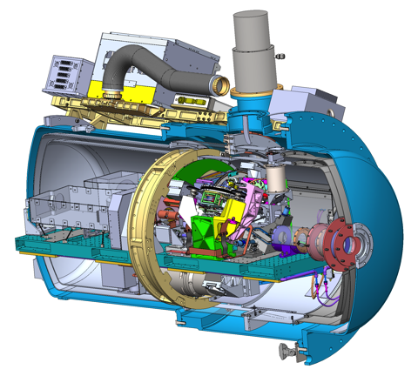
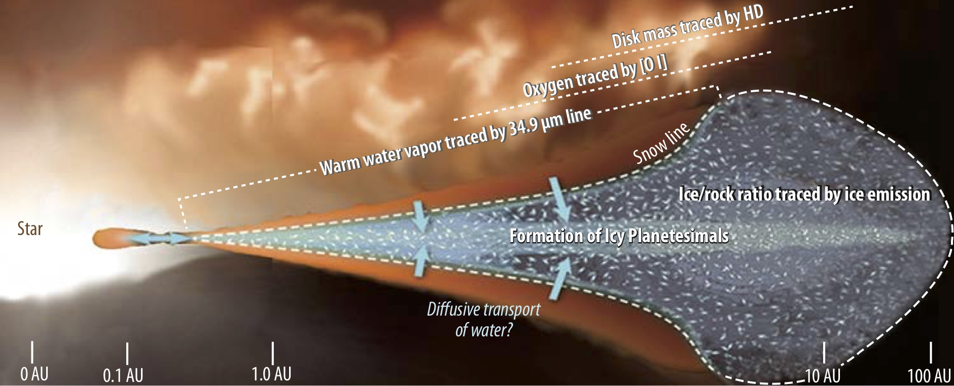
SOFIA’s high-resolution infrared spectrometer
HIRMES: HIgh-Resolution Mid-infrarEd Spectrometer, combining Fabry-Perot Interferometers and traditional gratings with diffraction- & background-limited TES bolometers.
Range: 25-122 µm; Spectral resolutions: R ≈ 2k, 600, 10k, 100k
Primary science case: Proto-planetary disk

