Slide 1
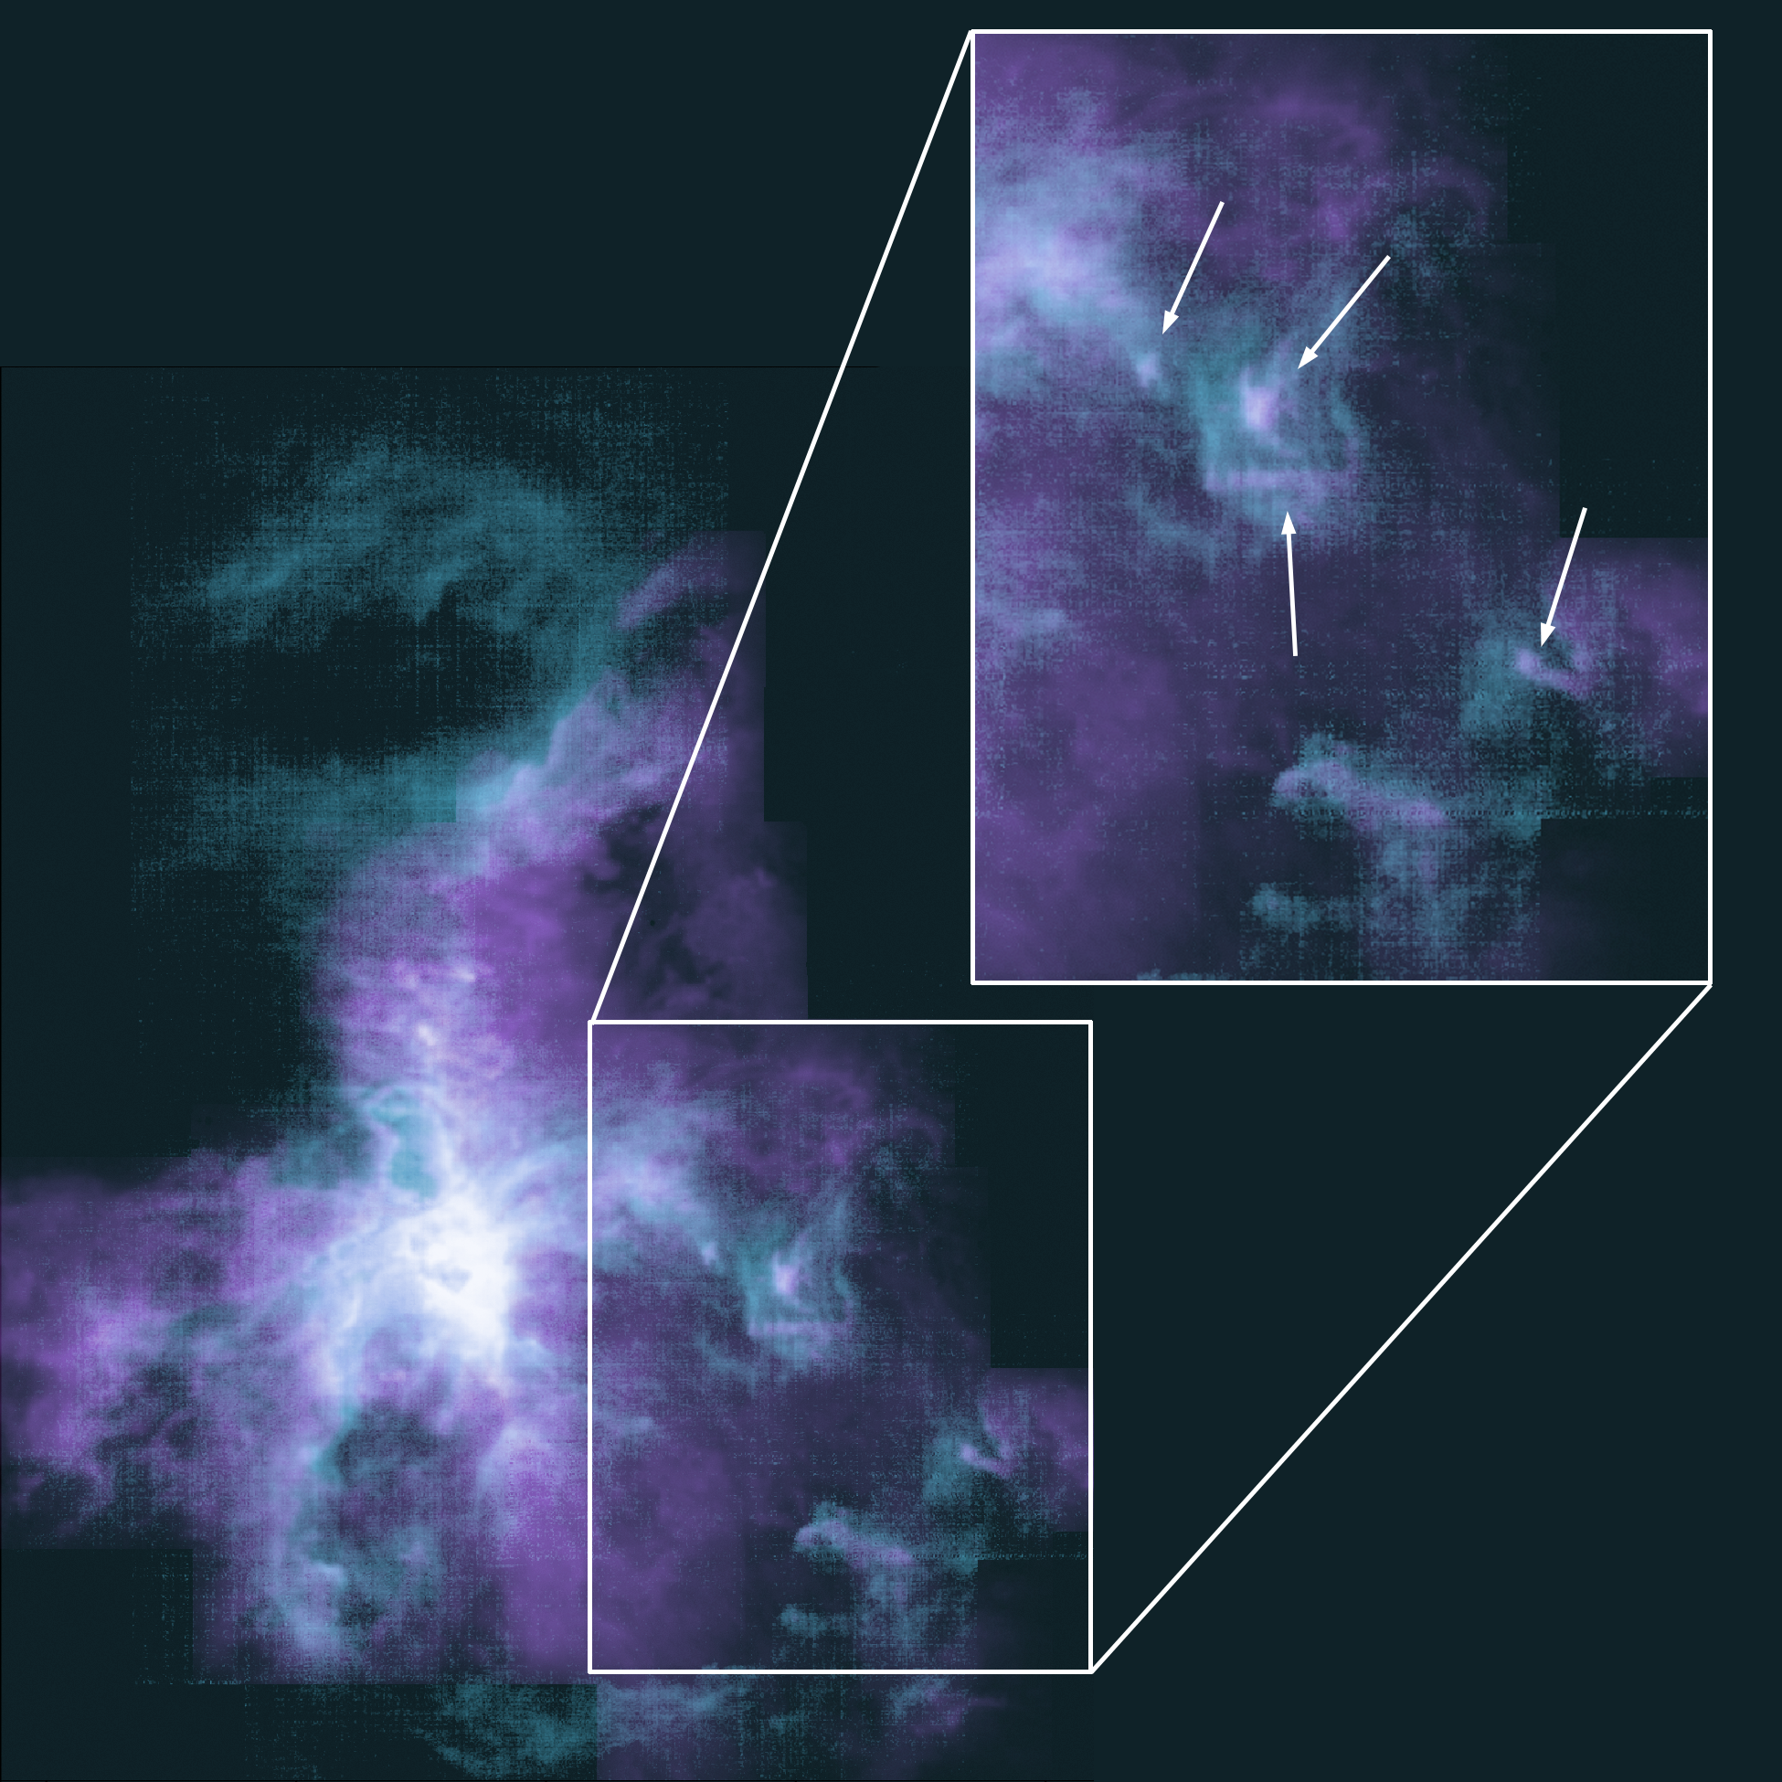
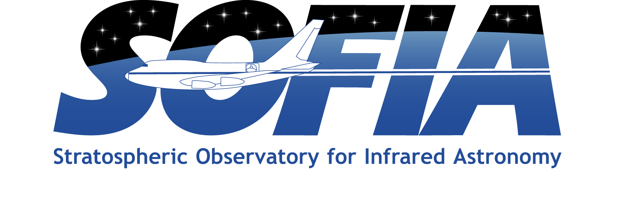

First Signs of Star Birth Triggered by Orion Wind
An enormous stellar wind in the Orion Nebula is blowing away its natal molecular cloud, forming a ridge of dense material along the edge of the resulting bubble. New results reveal signs of star birth along the edges within tiny, compacted clouds and offer new insights into how the stars of today can affect the stars of the future.
SOFIA/upGREAT observations, complemented by CO(2-1) velocity-resolved maps taken with the IRAM 30-meter radio telescope in Spain, show that there are dense clouds along the edges that have prime conditions for new stars, and in fact one newborn, low-mass star already seems to be forming in one of them. Some of the other new clouds may be temporary or easily dissipated by the wind and may never reach maturity.
The analysis indicates that the shell surrounding the Orion Nebula will most likely not form new stars, but different outcomes may result is other star-forming regions with varying circumstances
Paper: “Expanding bubbles in Orion A: [C II] observations of M 42, M 43, and NGC 1977”
Pabst, C. H. M., et al., 2020/07, A&A, 639A, A2.
Image credit: NASA/SOFIA/IRAM
Notes:
Paper DOI: http://doi.org/10.1051/0004-6361/202037560
High-res image link: https://www.sofia.usra.edu/sites/default/files/Public/SCI2021_005.png
Science Spotlight: https://www.sofia.usra.edu/multimedia/science-results-archive/first-signs-star-birth-triggered-orion-wind

